Slide 2
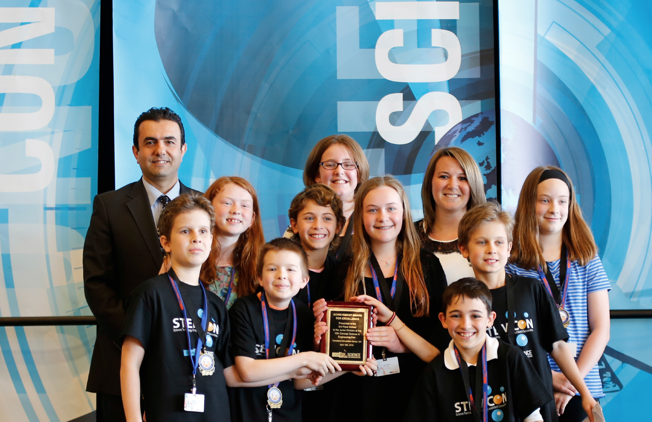
What is CYSP?
The Concept Young Scholars Program (CYSP) is a program that is offered to students in grades 5th-12th in all Concept Schools. CYSP focuses on academic challenges, healthy lifestyle, building confidence, volunteerism, exploration, and many fun activities.

Slide 3
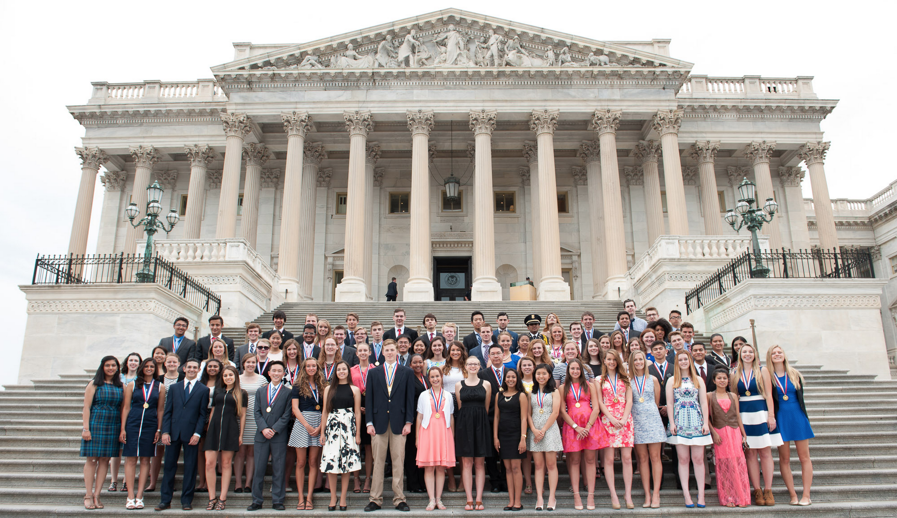
Inspired by Congressional Award
Concept Young Scholars will be able to use most of the activities for the congressional awards if they are willing to participate to that program as well. For more info, please see http://congressionalaward.org/

Slide 4
Personal Development
Voluntary Public Service
Expedition/ Exploration
Physical Fitness

Slide 5
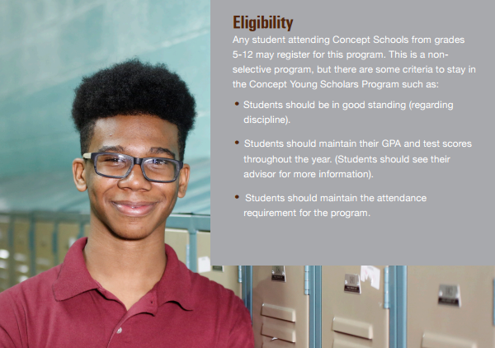

Slide 6
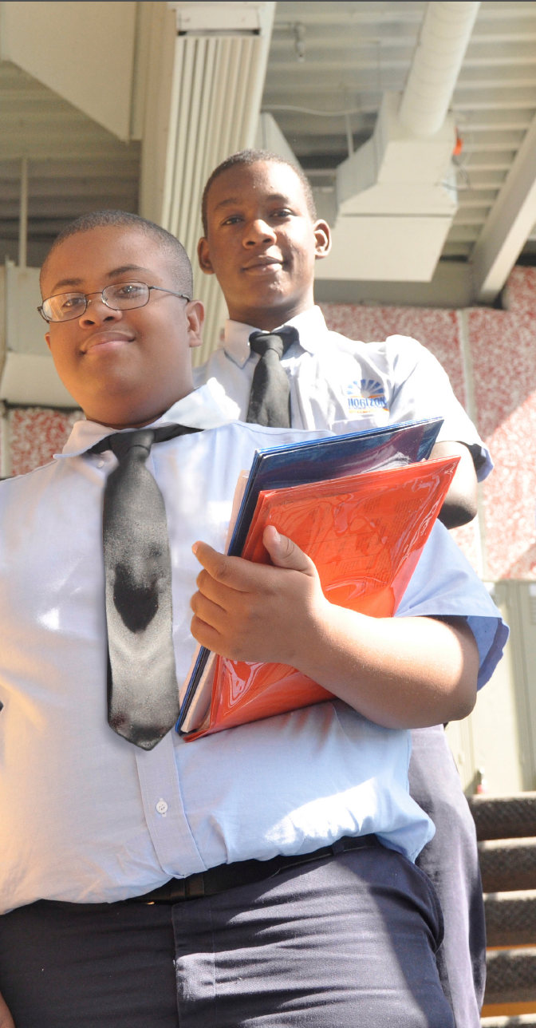
Interested students should receive and review the program folder.
Each student must select an advisor.
The scholars must keep their records up to date.
The scholars are responsible for making sure that related staff logs all attended program-related activities.
The scholars will meet with their advisor on a regular basis.

Slide 7
There are six levels of awards: Bronze, Bronze +(Plus) , Silver, Silver +(Plus) and Gold, Gold +(Plus) medals. All students who reach their goal also receive a certification of completion from Concept Schools.
Concept Schools will provide all medals and certificates; however each school will offer incentives and awards to their students.

Slide 8
The requirements for the CYSP program for 5th - 6th grades are outlined in this chart.
If Parents participate in; | Bronze + | Silver + | Gold +
CYSP in school events (dinner, seminar, presentation) | 4 times | 6 times | 8 times
CYSP out of school events (field, college Trip and Camp)
CYSP Relief Activity/Community Services with students
Progress Report Meeting with parent (home-visit, in/out of school meeting min 20 minutes)

Slide 9
The requirements for the CYSP program for 7th -8th grades are outlined in this chart.
If Parents participate in; | Bronze + | Silver + | Gold +
CYSP in school events (dinner, seminar, presentation) | 4 times | 6 times | 8 times
CYSP out of school events (field, college Trip and Camp)
CYSP Relief Activity/Community Services with students
Progress Report Meeting with parent (home-visit, in/out of school meeting min 20 minutes)

Slide 10
The requirements for the CYSP program for 9th-11th grades are outlined in this chart.
If Parents participate in; | Bronze + | Silver + | Gold +
CYSP in school events (dinner, seminar, presentation) | 4 times | 6 times | 8 times
CYSP out of school events (field, college Trip and Camp)
CYSP Relief Activity/Community Services with students
Progress Report Meeting with parent (home-visit, in/out of school meeting min 20 minutes)

Slide 11
The requirements for the CYSP program for 12th grade are outlined in this chart.
Category | Bronze | Silver | Gold
Progress Monitoring Meeting | 4 sessions | 6 sessions | 12 sessions
Character Education | 2 tasks | 4 tasks | 6 tasks
Reading | 1 book | 2 books | 3 books
Community Service | 4 hours | 6 hours | 10 hours
Overnight Activities | Optional | 2 times | 4 times
Intercultural Activities | Optional | 2 times | 3 times
Out of Town Trip | Optional | 1 time | 2 times
College Trip | 1 time | 2 times | 3 times
College Application / Scholarship Application | 2 times | 4 times | 8 times
College Life Readiness: Fafsa Dinner, Senior Night, Alumni Dinner, Senior+Alumni Picnic, Senior Trip, Luncheon with Admin, College Fair | 1 time | 2 times | 4 times
If Parents participate in; | Bronze + | Silver + | Gold +
CYSP in school events (dinner, seminar, presentation) | 4 times | 6 times | 8 times
CYSP out of school events (field, college Trip and Camp)
CYSP Relief Activity/Community Services with students
Progress Report Meeting with parent (home-visit, in/out of school meeting min 20 minutes)

Slide 12
CYSP Advisors’ Responsibilities
Meetings with the program coordinator.
Review program components and requirements with his/her scholars at the beginning of the year.
Periodic meetings with scholars in order to monitor the progress.
Entering the logs for all activities.
Organizing activities for his/her scholars in order to fulfill program requirements.
Supervision of the scholars at all activities unless assigned to any other adult.

Slide 13
for School Admin:
Understanding all program components.
Designation of school CYSP coordinator.
Presentation of the program to all staff during the teacher orientation.
for CYSP Coordinator:
Presentation of the program to eligible students.
Making sure students choose their advisors.
Collaboration with advisors to create an event calendar for students.
Monitoring scholars’ progress by checking their log books.
Organizing the end of year award ceremony and school wide CYSP events.

Slide 14
We believe that
with your support,
CYSP will engage
our students with
meaningful activities.
We all are excited to see the outcomes!

